Slide 1

NEIL GOGTE INSTITUTE OF TECHNOLOGY
INTERACTIVE MUSICAL KEYBOARD
Under the Guidance
of
Mrs. M Deepika
Assistant Professor
Department of Computer Science & Engineering(AIML)
2024 - 25

Slide 2
CONTENT:
TOPIC:
PAGE NUMBER:
INTRODUCTION
2
PROBLEM STATEMENT
3
EXISTING SYSTEM AND ITS DISADVANTGES
4-5
PROPOSED SYSTEM AND ITS ADVANTAGES
6-7
ARCHITECTURE OF PROPOSED SYSTEM
8
SYSTEM REQUIREMENT SPECIFICATION
9
SYSTEM DESIGN
10-12

Slide 3
Introduction:
This project focuses on developing an innovative musical keyboard application for Android, designed to make music creation intuitive, accessible, and versatile.
Featuring a sleek piano-style interface, the app allows users to explore their creativity by switching effortlessly between 128 instrument sounds.
Built with Android Studio, it combines a robust Java backend with a dynamic React Native frontend, ensuring a smooth, engaging user experience. This application caters to both beginners and advanced users, fostering musical exploration on the go.
- A Manidhar (2453-21-748-038)
- Sri Chandra Vardhan (2453-21-748-057)
- T Vishnu Vandhan (2453-21-748-058)

Slide 4
Problem Statement:
The project aims to address common barriers in music creation tools by developing an intuitive Android musical keyboard app.
Each key corresponds to a specific musical note, providing a realistic piano experience. Utilizing Android Studio, the app’s Java backend ensures reliable performance, while the React Native frontend delivers a visually appealing and responsive design.
Additional features include seamless switching between 128 instrument sounds, offering users a wide range of creative possibilities. This system prioritizes accessibility, usability, and versatility for music enthusiasts of all levels.

Slide 5
Existing System:
Current music systems, such as DAWs, virtual pianos, educational software, and gaming keyboards, offer diverse features for music creation but face notable challenges. Many lack user-friendly interfaces and seamless error handling, making them difficult for beginners to navigate.
Additionally, these systems often depend on specific software, high-end hardware, or constant internet connectivity, limiting accessibility for a broader audience. The steep learning curves associated with many tools can overwhelm newcomers, discouraging them from exploring their full potential.
Furthermore, the high cost of professional-grade tools and complex setup requirements make it difficult for hobbyists or users with limited resources to engage in music production. Many systems also fail to integrate smoothly with other music tools, reducing their overall functionality. These limitations create barriers for both aspiring musicians and casual users, preventing them from easily creating music in a way that suits their needs and preferences. The lack of flexibility and adaptability in existing systems also stifles creative expression for a wide range of users.

Slide 6
Existing System Disadvantages:
Current music systems like DAWs, virtual pianos, and educational tools face these key limitations:
Limited Customizability: Restricted options for personalizing sounds or settings.
Complexity: Steep learning curves for beginners.
Error Handling: Inefficient recovery from user errors.
Platform Dependency: Limited flexibility across devices.
Integration Issues: Poor connectivity with other tools.
High Cost: Expensive licenses for advanced tools.
Hardware Demands: Require high-performance devices.
Online Dependence: Limited offline functionality.

Slide 7
Proposed System:
The Android application is built using a combination of Java for backend processes and React Native for the frontend, ensuring a smooth and interactive user interface. The frontend features a visually engaging GUI, including piano keys and the ability to select from 128 instrument sounds, catering to a wide range of musical preferences.
For handling instrument mapping and MIDI functionalities, Python MIDI libraries such as mido or python-rtmidi are integrated, ensuring robust and precise sound processing. Java complements this setup by optimizing backend performance, ensuring efficient communication between the frontend and backend systems.
The mobile interface prioritizes user experience by incorporating comprehensive error handling mechanisms, minimizing disruptions during usage. Additionally, the app is regularly updated based on user feedback, continuously refining its features and usability to meet diverse needs effectively.

Slide 8
Proposed System Advantages:
Portable: Accessible on Android anytime, anywhere.
Beginner-Friendly: Intuitive interface with no steep learning curve.
Versatile: Offers 128 instruments for creative exploration.
Stable: Java backend ensures smooth performance.
Seamless: Error handling minimizes disruptions.
Expandable: React Native enables future cross-platform support.
Collaborative: Open-source for community-driven improvements.
Affordable: Free, cost-effective alternative to pricey tools.

Slide 9
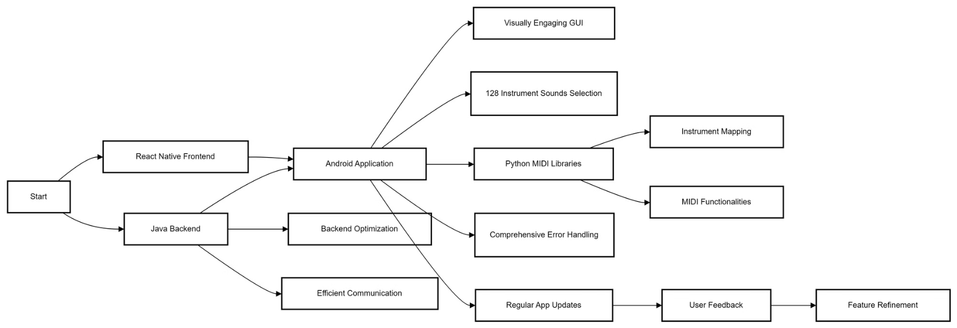
Architecture of Proposed System:

Slide 10
System Requirements Specification (SRS):
Software Requirements:
Hardware Requirements:
Operating System: Android 7.0 (Nougat) or higher.
Device: Android smartphone or tablet.
Storage: Minimum 100 MB free space for app installation.
Processor: Quad-core processor or better for smooth performance.
Internet Connection: Required for app updates and online features, if any.
RAM: 2 GB minimum, 4 GB or more recommended for optimal experience.
MIDI Controller (Optional): For users wanting to connect external MIDI instruments.

Slide 11
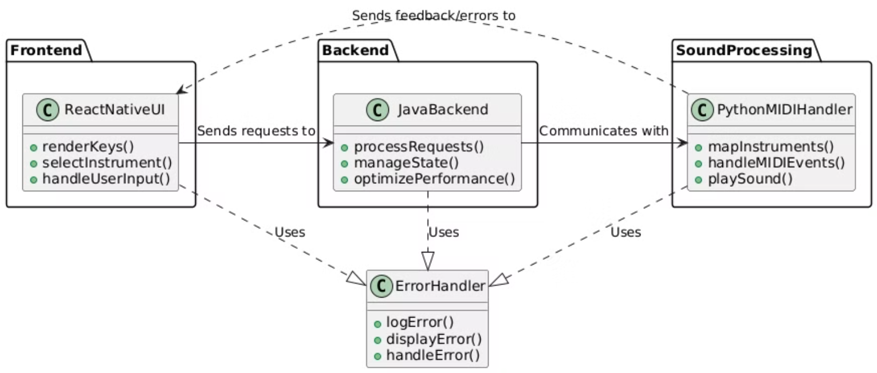
System Design:
CLASS DIAGRAM:

Slide 12
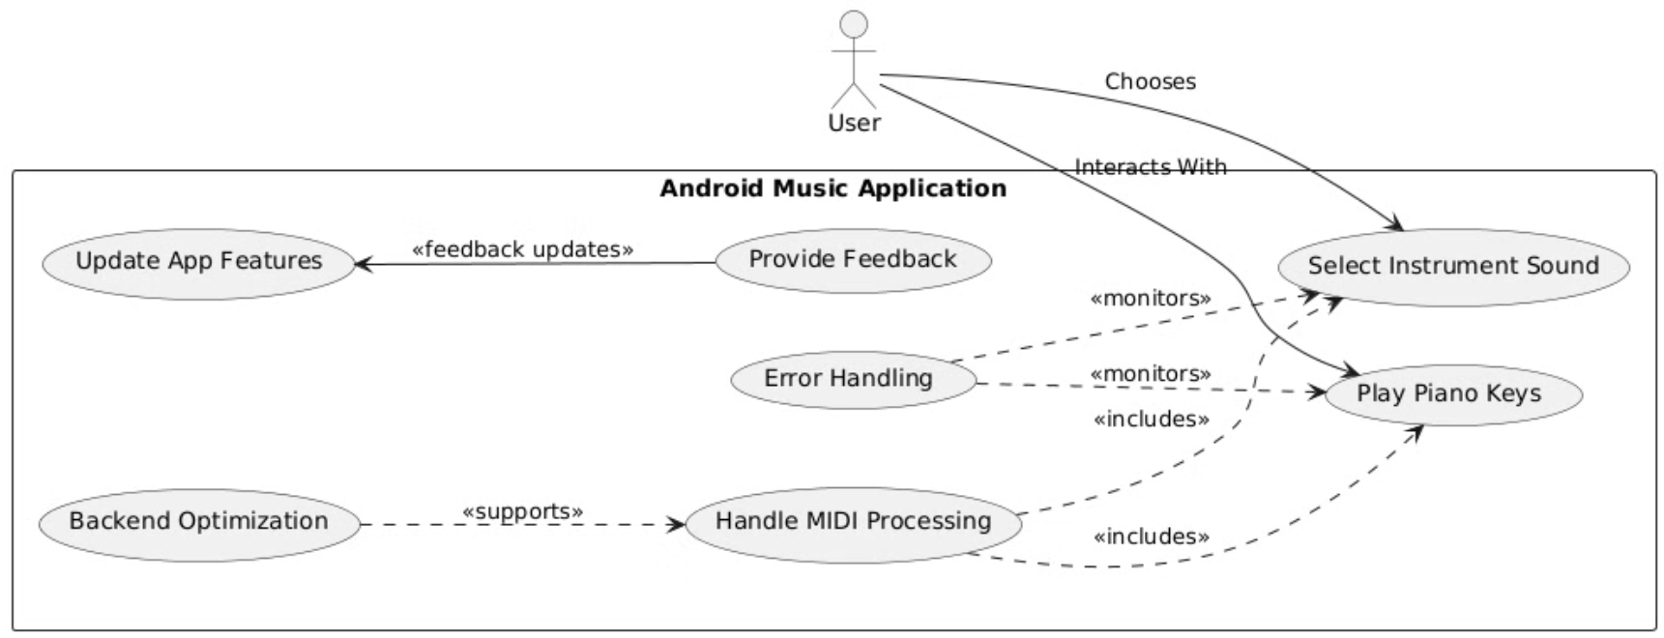
USE CASE DIAGRAM:

Slide 13
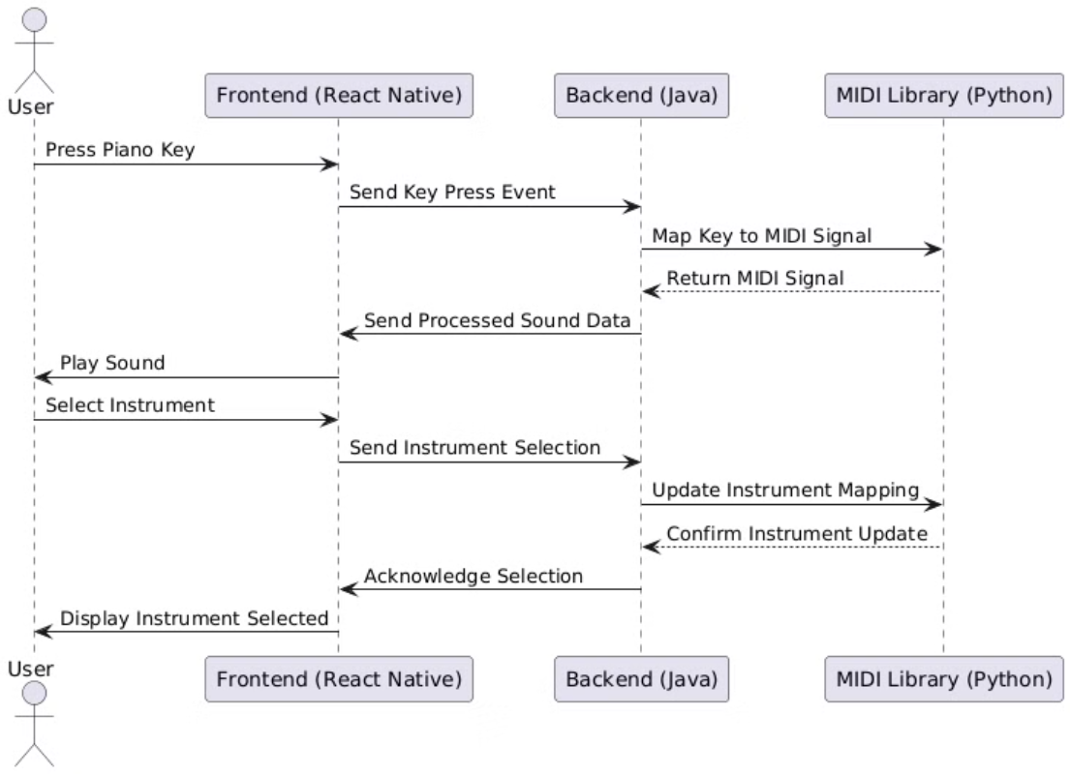
SEQUENCE DIAGRAM:

Slide 14
CONCLUSION:
The proposed system addresses the limitations of existing music systems by offering a user-friendly, accessible, and feature-rich Android application. By leveraging React Native for an engaging frontend and integrating Python MIDI libraries for robust sound processing, the app ensures seamless functionality and versatility. The use of Java for backend optimization enhances performance and ensures reliable communication between components.
This system lowers the barriers for music creation by offering a simplified interface, comprehensive error handling, and the flexibility to choose from a wide range of instrument sounds. Its affordability and adaptability make it ideal for both beginners and casual users, promoting creative expression without the need for specialized hardware or constant internet connectivity. By prioritizing user feedback and iterative improvements, the application fosters a more inclusive and empowering environment for music enthusiasts of all skill levels.

Slide 15
THANK YOU!

